Slide 1
7:50–8:00pm
Welcome to Back-to-School Night 4th Block Conceptual Chemistry, A223 Terri Mehalick & Kelly Wingen
Please take an index card and write (1) your name, (2) your student’s name, and (3) at least one thing that you think I should know about your student to help them succeed.
For your reference, tonight’s PowerPoint will be posted on SchoolWires: https://www.cbsd.org/tmercer

Slide 2
Kelly Wingen

Slide 3
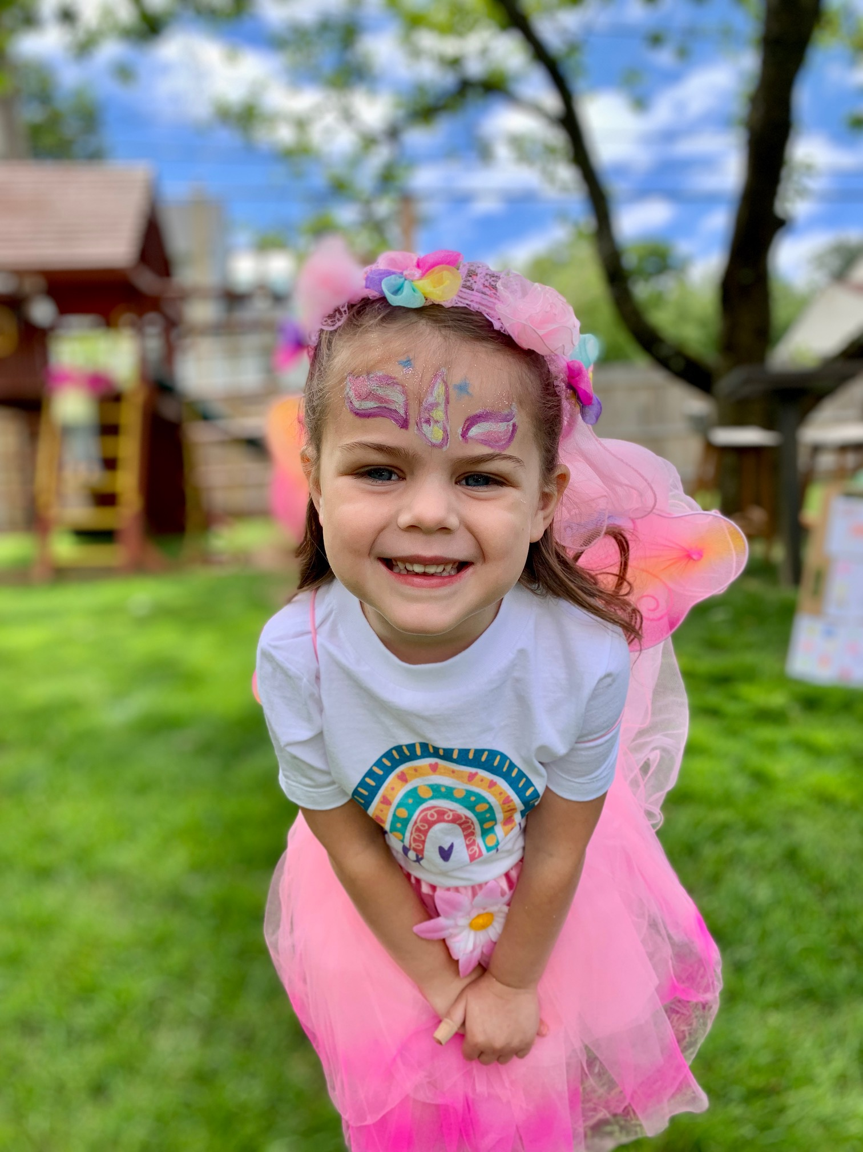
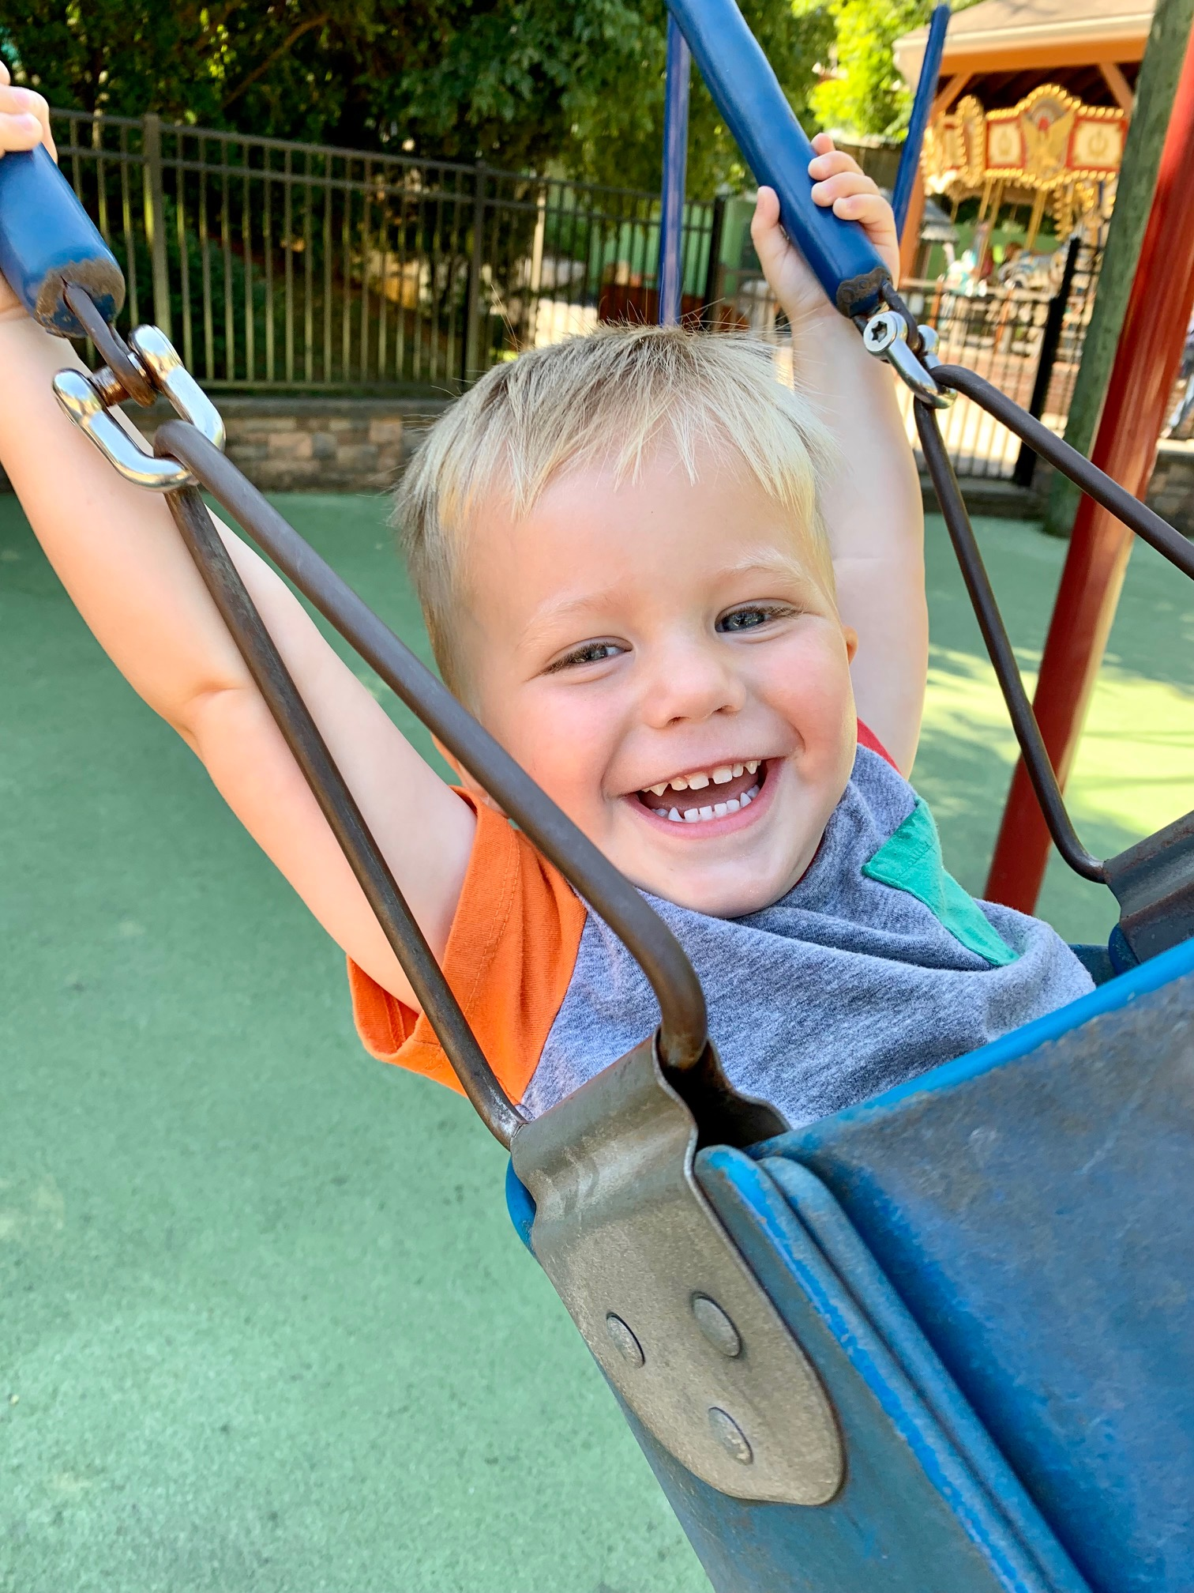
Terri Mehalick Conceptual, Academic, Honors, & AP Chemistry
Cabrini University M. Ed. (2016)
CB West High School
Fall ’14 – Present
CB East High School
Spring ’14 – Spring ’15
CB South High School
Fall ’12 – Spring ’14
Pennsylvania State University B.S. Secondary Education, Chemistry option (2012)

Slide 4
Collaboration / Support Have you updated your email in Parent Portal? Have you registered to be a Canvas “Observer”?
We also collaborate regularly with fellow Conceptual Chemistry teachers, educational aides, & case managers

Slide 5
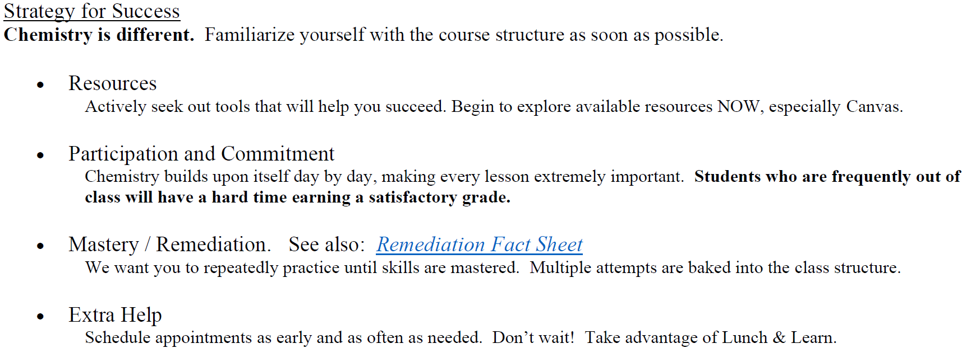
Course Fact Sheet

Slide 6
Grades: Overview 50% MP1 50% MP2 Final Project in MP2
No Core Assessments
No Final Exam
SUMMATIVE90
90% of MP grade
Exams
Fri Review Quizzes
Final Project
FORMATIVE 10
10% of MP grade
Notebook items
Labs
Assignments
(points vary)
(100 points)

Slide 7
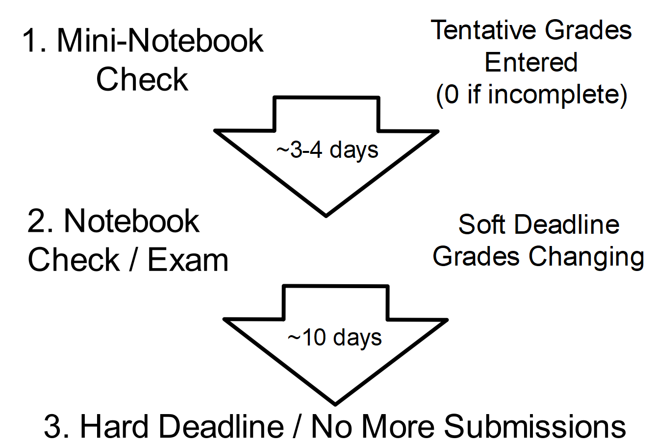
Grades: Deadlines

